Slide 1

RocksDB Festival
Supported by IITP, StarLab.
July 26, 2021
송인호, 한예진
inhoinno@dankook.ac.kr , hbb97225@naver.com
TeamName : 멘탈모델을 만들고 싶어요

Slide 2
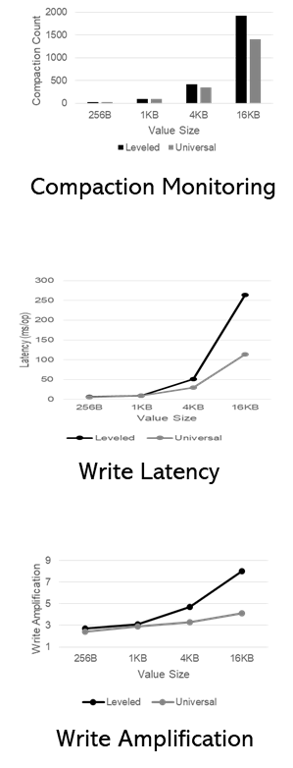
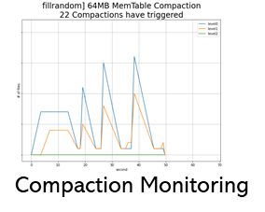
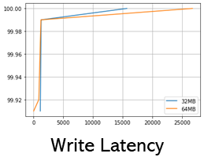
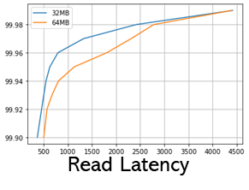
Contents
Last Week
컴팩션에 영향을 미치는 녀석들 #1 KV Size
컴팩션에 영향을 미치는 녀석들 #2 SST Size
This Week
Mental Model
Alleviating [PROBLEMS] of Level Compaction by [Method] in Universal Compaction
Leveled vs Universal Compaction Comparison
Throughput
Write Amplification
Latency distribution + # of Compactions
Read/Space Amplification
2

Slide 3
Compaction Style
Leveled Compaction, Universal Compaction
Sorted Level vs Sorted Run
Example of LeveledCompaction
Example of Universal Compaction
level
level
0
1
2
0
1
2
0
1
2
7
insert 13
0
1
2
0
1
2
0
1
2
7
insert 13
1 3
10 19
Flush &
merge
3 19
1 10
2 4 8 12 15 18
2 4 8 12 15 18
flush
move
merge &
move
1 3
7 10 13 19
3 19
1 10
7 13
2 4 8 12 15 18
2 4 8 12 15 18
merge
1 2 3 4 7 8
10 12 13 15 18 19
2 4 8 12 15 18
1 3 7 10 13 19

Slide 4

Mental Model
RocksDB
레벨 컴팩션의 문제점을
유니버셜 컴팩션의 “__“
으로
완화할 수 있다

Slide 5
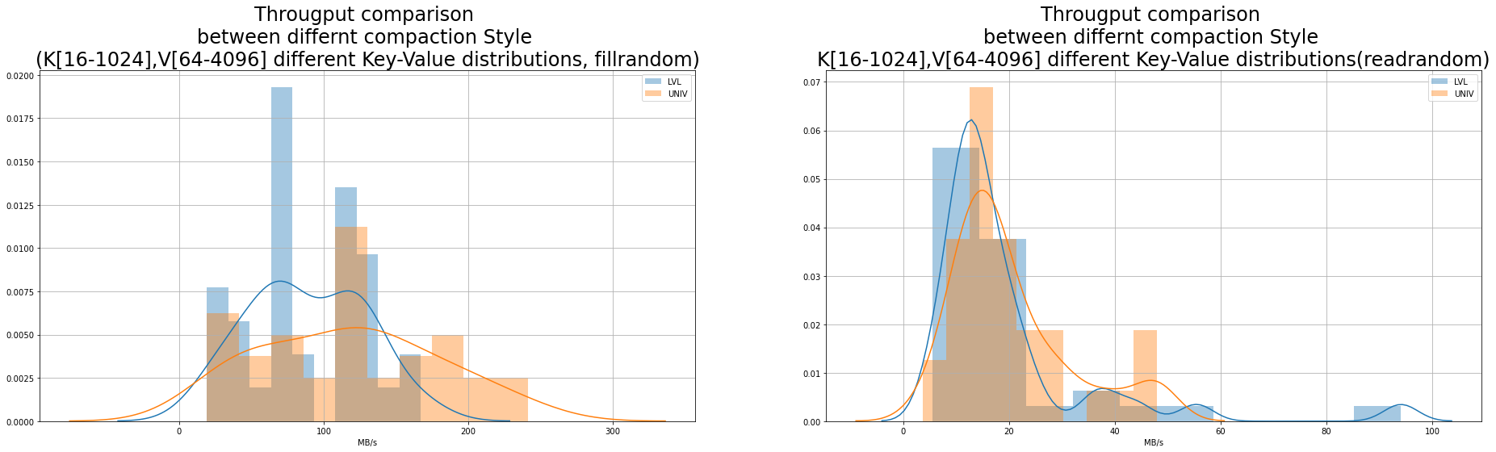
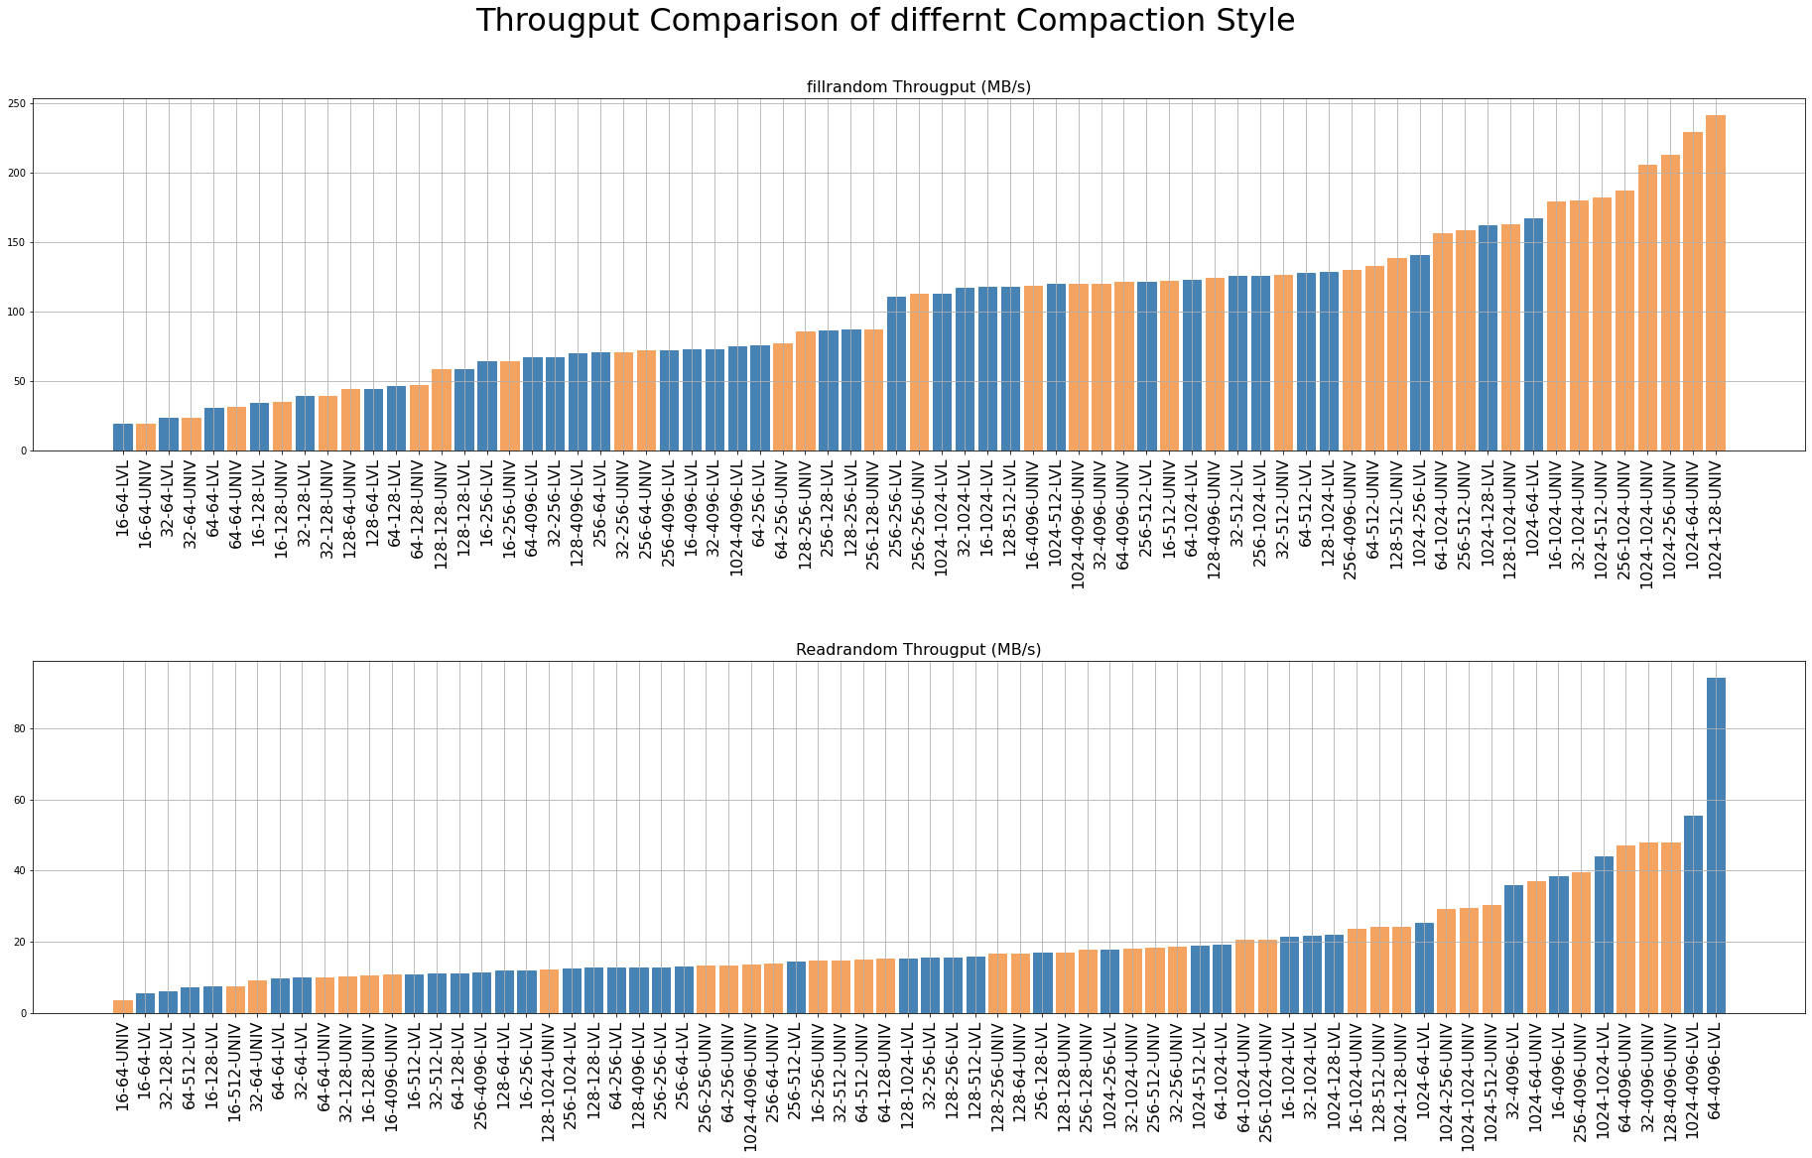
LVL vs Univ Throughput Comparison
Fillrandom
Key [16, 32, 64, 128, 256, 1024]
Value [64, 128, 256, 512, 1024, 4096]
Entries 500 0000
Storage Samsung 1TB 860 Pro
File System Ext4
CPU Intel(R) Core(TM) i7-10700K CPU @ 3.80GHz
LVL Compaction
Univ Compaction
Left is better
LVL Compaction
Univ Compaction
MB/s

Slide 6
LVL vs Univ Throughput Comparison
Readrandom
--use_existing_db
Key [16, 32, 64, 128, 256, 1024]
Value [64, 128, 256, 512, 1024, 4096]
Entries 500 0000
Storage Samsung 1TB 860 Pro
File System Ext4
CPU Intel(R) Core(TM) i7-10700K CPU @ 3.80GHz
LVL Compaction
Univ Compaction
Left is better
LVL Compaction
Univ Compaction
hard to define
what it is…
MB/s

Slide 7
LVL vs Univ Throughput Comparison
Optimal Key Size
Readrandom
--use_existing_db
Key [16, 32, 64, 128, 256, 1024]
Value [64, 128, 256, 512, 1024, 4096]
Entries 500 0000
Storage Samsung 1TB 860 Pro
File System Ext4
CPU Intel(R) Core(TM) i7-10700K CPU @ 3.80GHz
LVL Compaction
Univ Compaction
1/time
Left is better
MB/s
LVL Compaction
Univ Compaction
MB/s
☞ 마치 Value Size에 맞는 Optimal Key Size가 있는 것 처럼 보인다

Slide 8
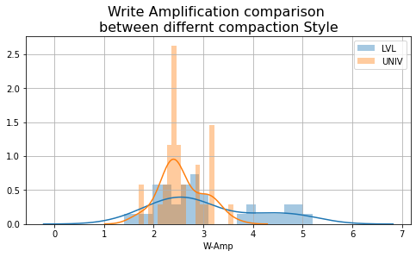
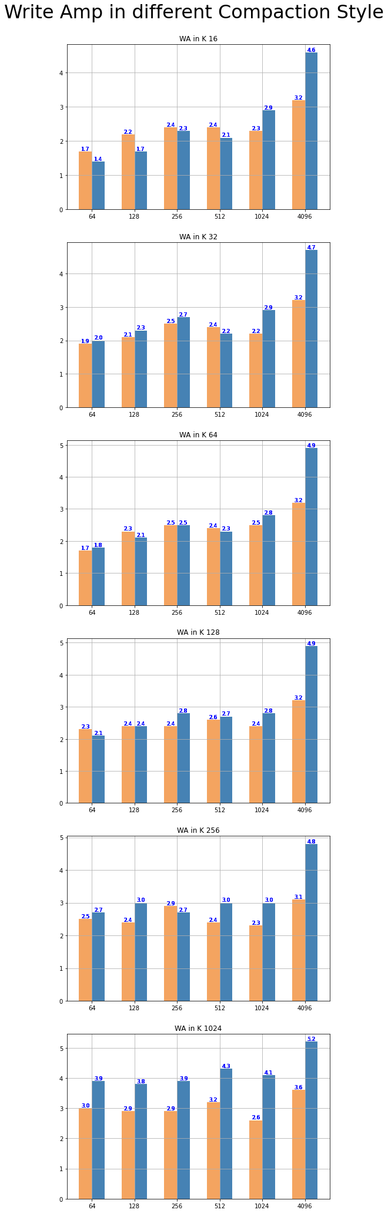
LVL vs Univ WAF Comparison
LVL Compaction
Univ Compaction
LVL Compaction
Univ Compaction
LVL Compaction
Univ Compaction

Slide 9
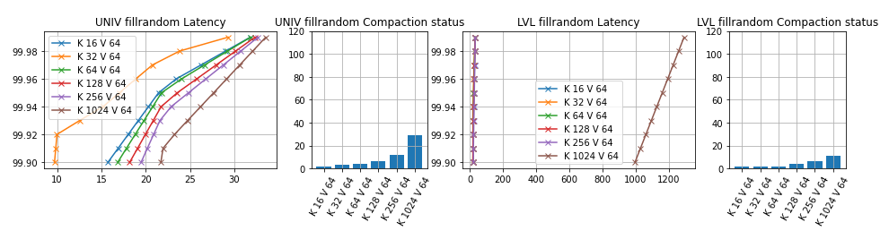
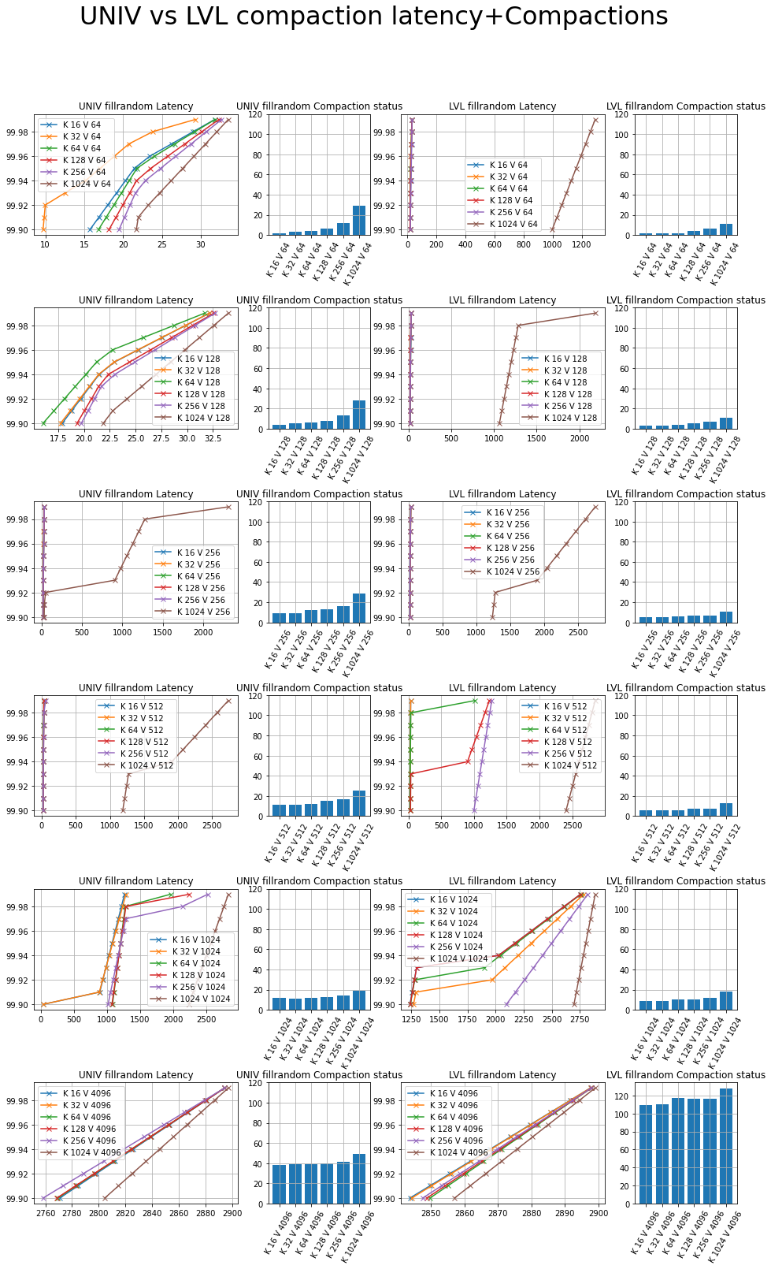
LVL vs Univ # of Compactions , latency Comparison
Fillrandom

Slide 10
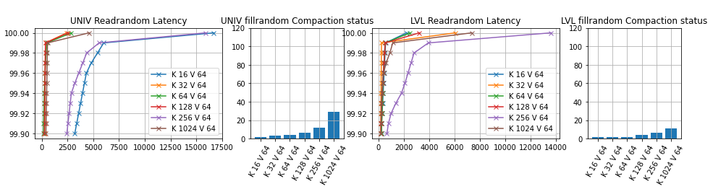
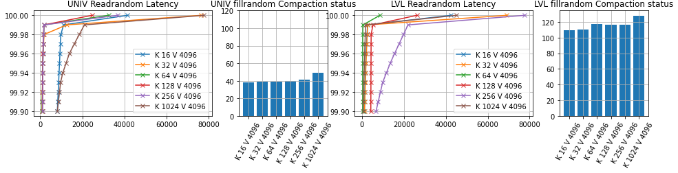
LVL vs Univ # of Compactions / latency Comparison
Readrandom

Slide 11
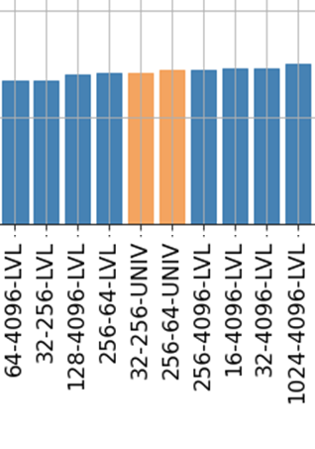

Issue on Last week
Throughput(KOPS)
Throughput(MB/s)
☞ 한 쪽은 OPS, 한 쪽은 MB/s 임.
즉, KV Size가 늘어날 수록 MB/s는 늘어나고, OPS는 줄어들게 됨

Slide 12
Next Week
Mental Model
Leveled vs Universal Compaction 관련 논문 조사
Hybrid Compaction 고민
Leveled vs Universal Compaction Comparison
Read 성능에 대한 fine grain 측정 – Read 부분별 시간 측정
Space Amplification 측정
Read Amplification 측정

Slide 13
Discussion

Slide 14
Appendix

Slide 15
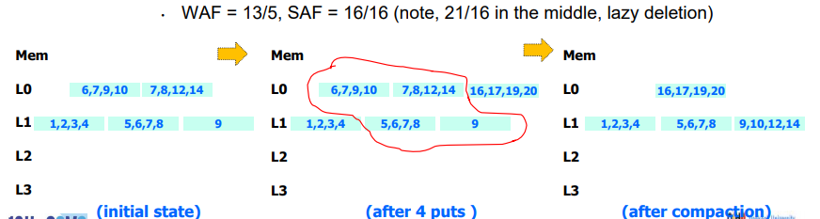


How to estimate Space Amplification Factor?
$SAF=\frac{Actual used space}{Required space }$ $= \frac{DB에 실제로 저장된 공간}{최소로 필요한 공간}$
☞ Not so simple
Jongmoo Choi, Key-Value Store: Database for Unstructured Bigdata (Focusing on RocksDB), 12th CSMS 융합〮스마트미디어 시스템 워크샵
☞ 중첩된 KV 를 고려하지 않아야함
☞ ☞ 따라서, (바라건대,) Sequential pattern 으로 쓰인 Size를 $′최소로 필요한 공간^{′}$ 으로 두고 구할 예정.
☞ Comment Plz

Slide 16
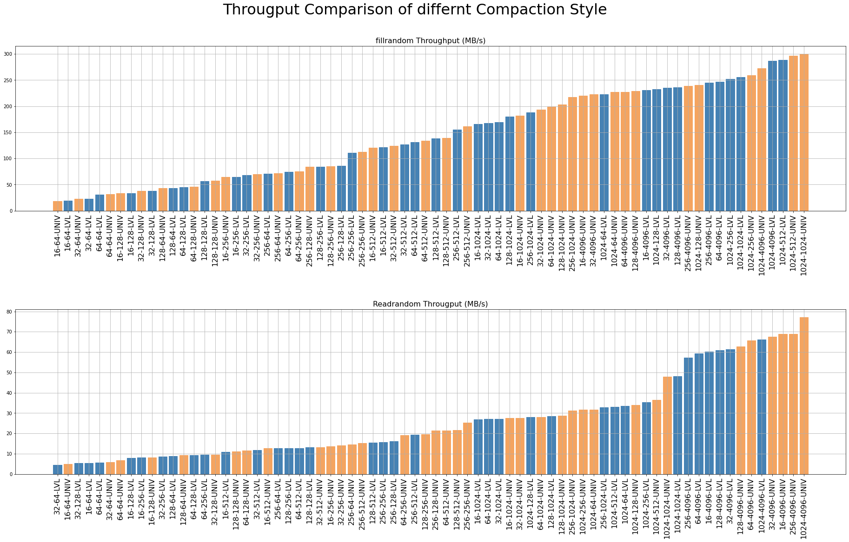

When we fix the DB size (Request size $≈$ 2.4GB)
현재 Request size = 800GB로 수정하고 DB bench 실험중..

Slide 17
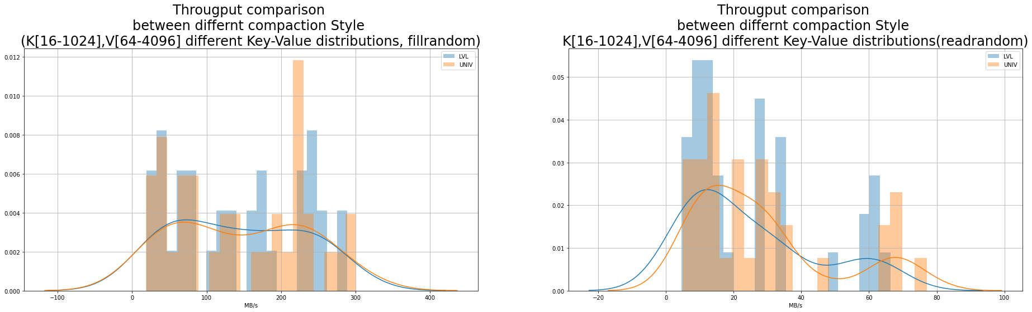

When we fix the DB size (Request size $≈$ 2.4GB)
현재 Request size = 800GB로 수정하고 DB bench 실험중..

Slide 18
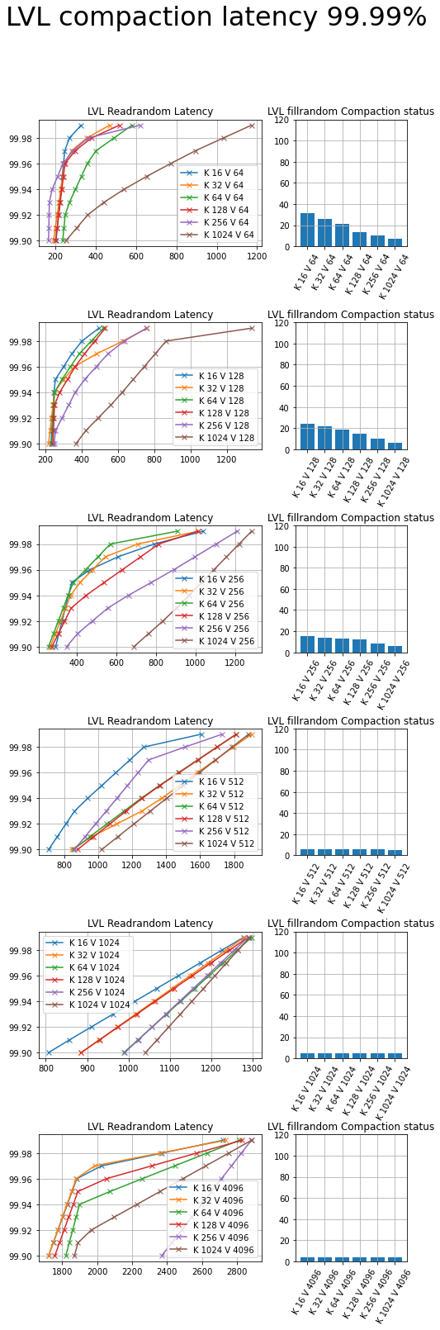
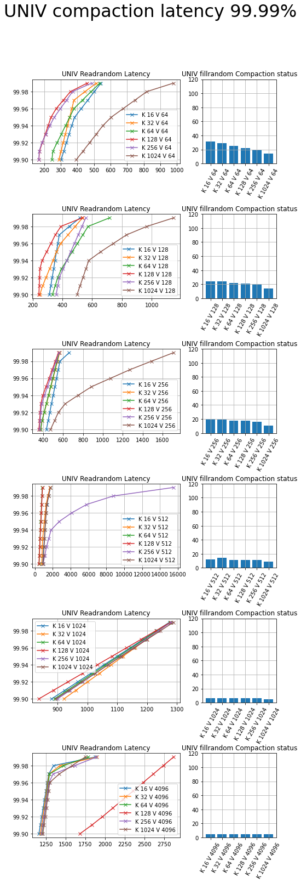

When we fix the DB size (Request size $≈$ 2.4GB)

Slide 19
Last Week

Slide 20
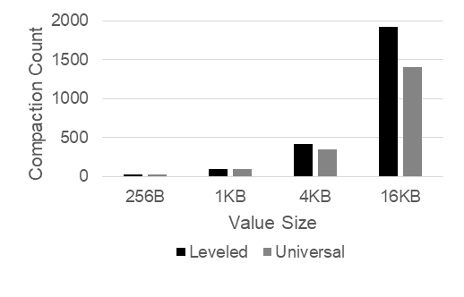
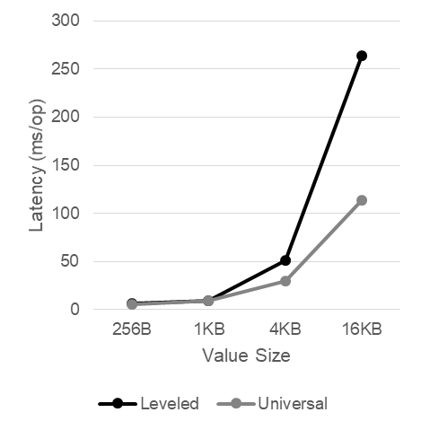
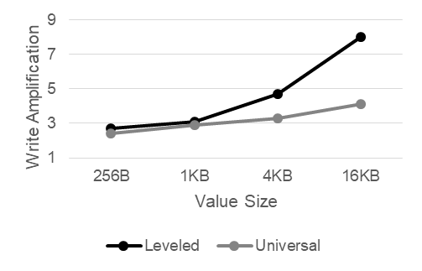
Compaction에 영향을 미치는 녀석들
#1 KV-Size
Various Key Size
Key: 16B, 32B, 64B, 128B
Value: 8K
fillrandom, readrandom, range query, 5000000
Leveled Compaction vs. Universal Compaction
Write Amplification
Various Value Size
Key: 16B
Value: 256B, 1KB, 4KB, 16KB
fillrandom, readrandom, range query, 5000000
Leveled Compaction vs. Universal Compaction
Write Amplification
+YCSB Workload, compare Read/Space Amplification
Compaction Monitoring
Write Latency
Write Amplification

Slide 21
RocksDB Festival
RocksDB::Compaction
Trial#3 Compaction on various Key size (random write)
Throughput
Compaction
Latency
WAF
21

Slide 22
RocksDB Festival
RocksDB::Compaction
Trial#4 Compaction on various Value size (random write)
Throughput
Compaction
Latency
WAF
22

Slide 23
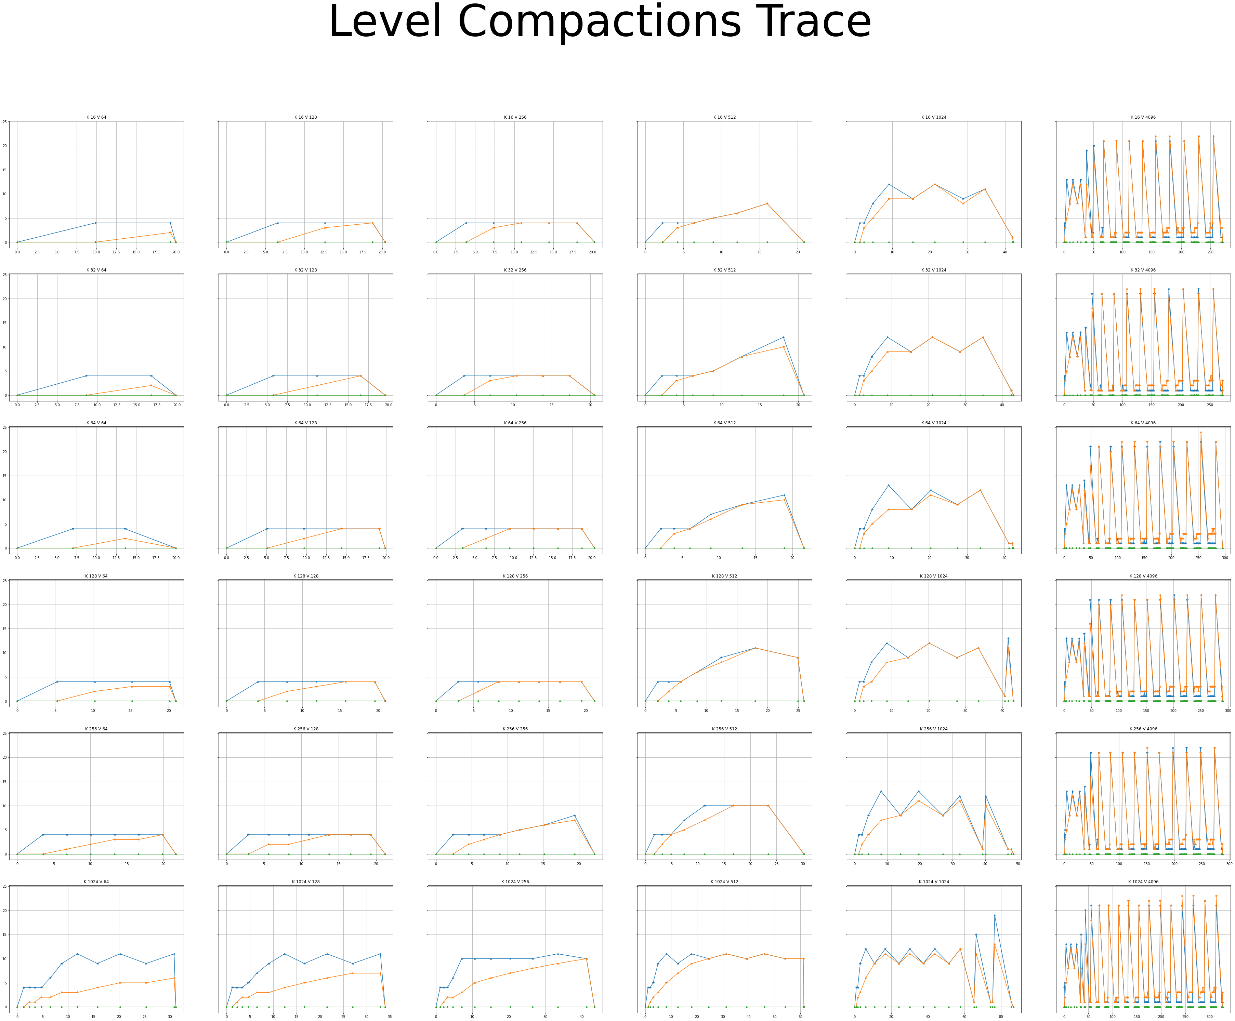

Slide 24
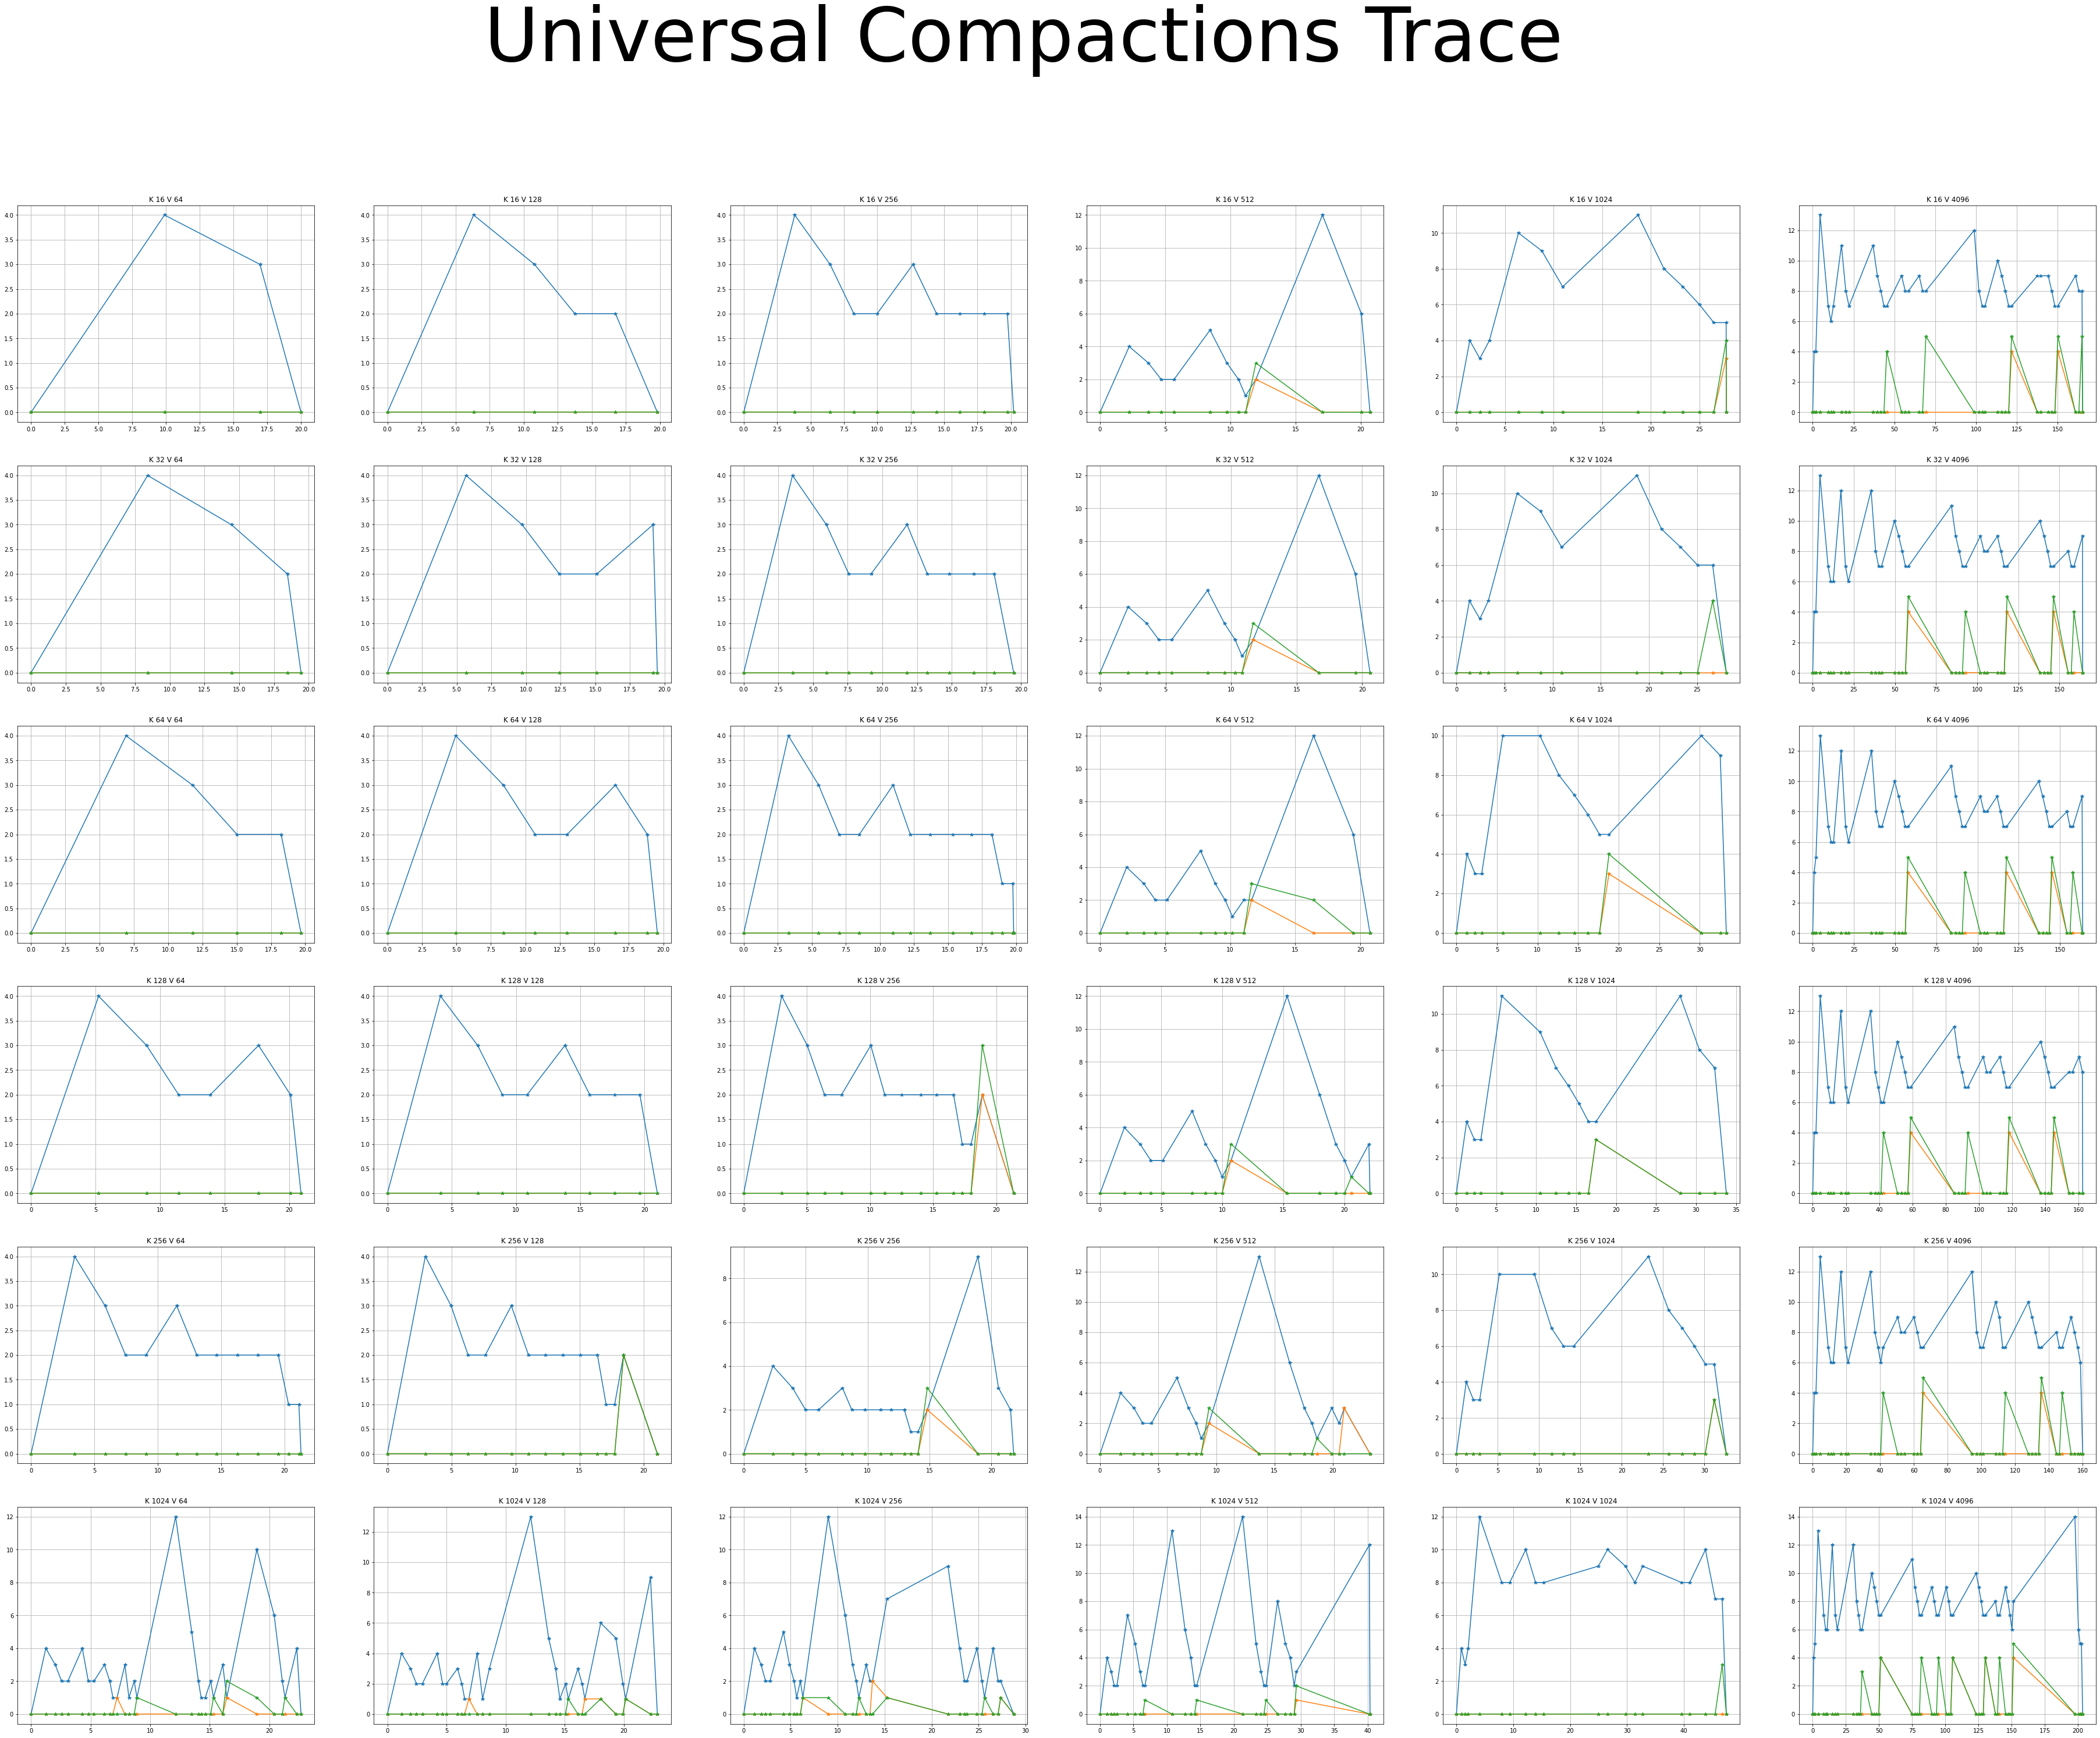

Slide 25
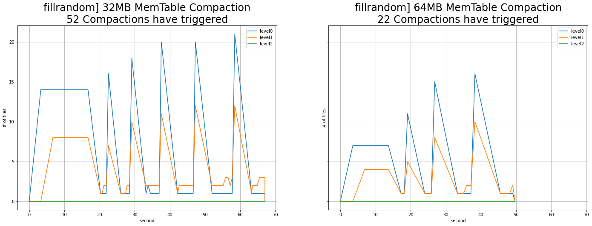
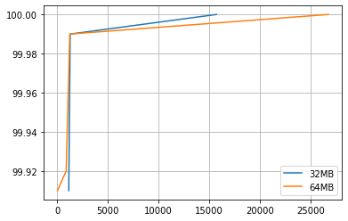
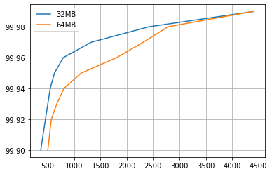
Compaction에 영향을 미치는 녀석들
#2 MemTable, SSTable
Various MemTable + Various SST
64MB, 32MB
fillrandom, readrandom, 16-512, 10000000
Various MemTable + 64MB SST
64MB, 32MB, 16MB, 8MB, 4MB, 2MB
fillrandom, readrandom, 16-512, 10000000
Compaction Monitoring
Write Latency
Read Latency

Slide 26
RocksDB Festival
Compaction::SSTable
Trial#1 Compaction on MemTable size&Target File Size (32MB vs 64MB)
☞
26

Slide 27
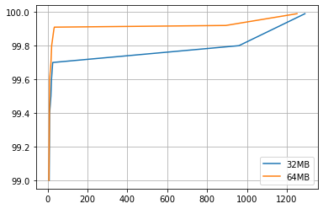
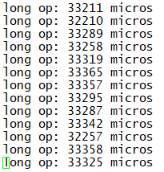
RocksDB Festival
Compaction::SSTable
Trial#1 Compaction on MemTable size&Target File Size (32MB vs 64MB)
fillrandom] Write Latency (99%)
readrandom] Read Latency (99%)
☞ Read/Write latency Trade-off on MemTable Size
27

Slide 28
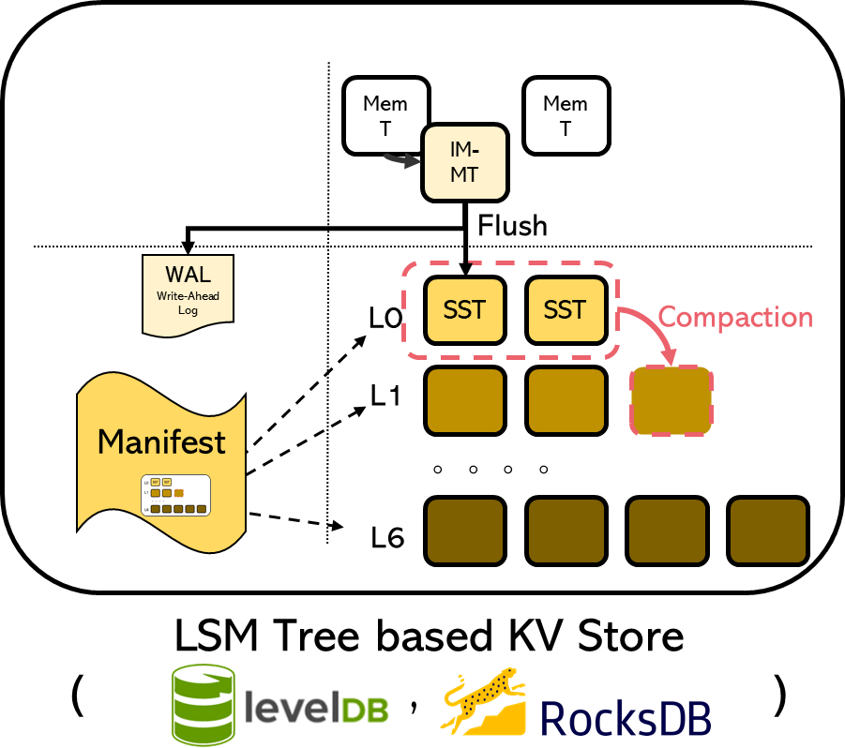
RocksDB Festival
Compaction::SSTable
Trial#2 Compaction on MemTable size, but Target File Size 64MB (MemT=[2,4,8,16,32,64]MB, SST_Level1 = 64MB)
Mem
Table
L0
SST
2MB
~
64MB
L1
SST
64MB
☞
28

Slide 29
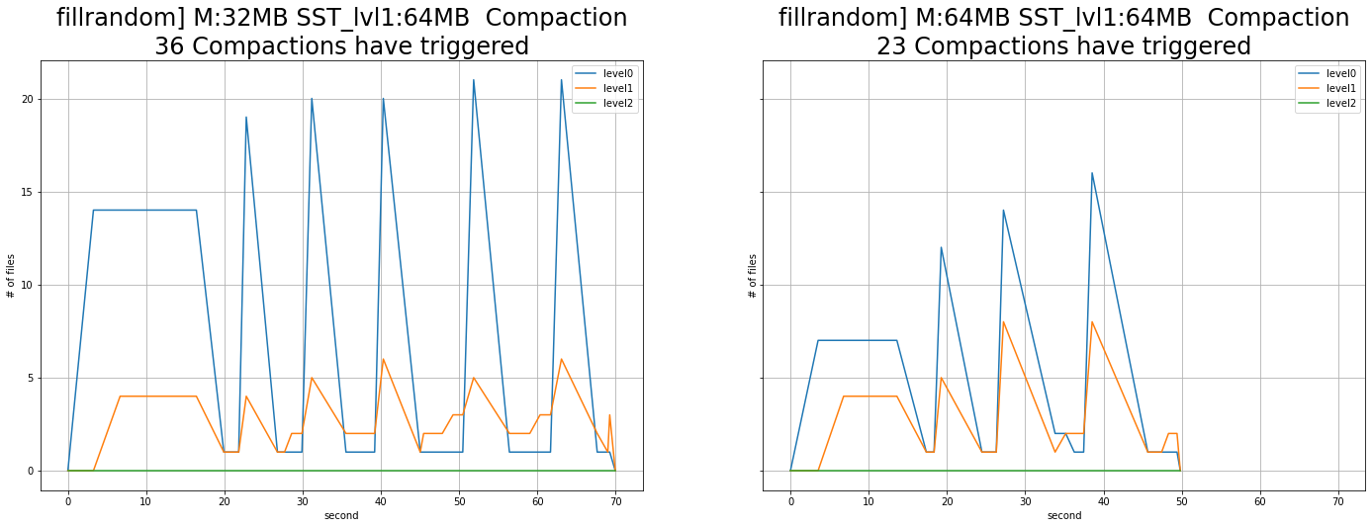
RocksDB Festival
Compaction::SSTable
Trial#2 Compaction on MemTable size, but Target File Size 64MB (MemT=[2,4,8,16,32,64]MB, SST_Level1 = 64MB)
☞ No difference between previous experiment
29

Slide 30
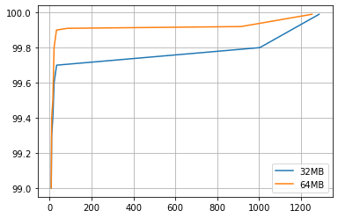
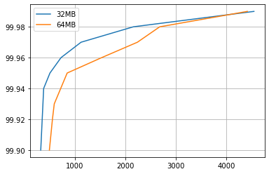
RocksDB Festival
Compaction::SSTable
Trial#2 Compaction on MemTable size&Target File Size (32MB vs 64MB)
fillrandom] Write Latency (99%)
readrandom] Read Latency (99%)
☞ No difference between previous experiment
30

Slide 31
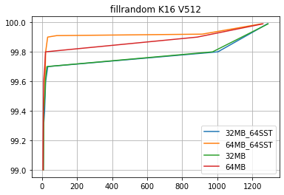
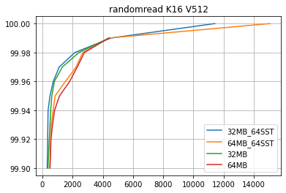

RocksDB Festival
Compaction::SSTable
Trial#1 vs Trial#2
fillrandom] Write Latency (99%)
readrandom] Read Latency (99%)
☞ ..?
31

